Slide 1


RAINFALL PREDICTION USING LINEAR REGRESSION
A GUI Application
SURAJ SATHEESH 20230804050

Slide 2
Introduction
This project is focused on researching the weather patterns of Thiruvananthapuram, Kerala. The region's climate is characterised by rainfall throughout the year, which holds significant importance for the area's agriculture, water management, and overall capacity to withstand natural calamities.
I developed GUI application that utilises linear regression techniques for rainfall prediction.

Slide 3
Technologies Used
The technologies and libraries used:
Tkinter: GUI library for creating the main application window and UI components.
Pandas:Data manipulation library for handling and cleaning datasets.
Sickit-learn: LinearRegression from sklearn used to create a linear regression model. In scikit-learn, the library used for this project, the LinearRegression class implements OLS linear regression. OLS linear regression aims to minimise the sum of the squared differences between the observed and predicted values.
matplotlib.pyplot: Used for plotting line graph.

Slide 4
Linear Regression
Linear regression is a type of supervised machine learning algorithm, used for modelling the relationship between a dependent variable and one or more independent variables. The core idea behind linear regression is to find the best-fitting linear relationship that can describe the variation in the dependent variable based on the values of the independent variables.

Slide 5
Development Enviornment
Hardware Specification:
MacBook Air 13, M2
8 core CPU and 8 core GPU
8GB LPDDR5 RAM and 256 GB SSD
MacOS Sonoma
Software Stack
VS Code
Jupyter notebook
Python

Slide 6
Dataset
The dataset was sourced from Kaggle, it provided historical weather data for Thiruvananthapuram, Kerala
The dataset covers time period, ranging from [start date] to [end date]. Each entry in the dataset represents daily observations, providing a comprehensive overview of Thiruvananthapuram's weather patterns.
Key variables within the dataset include Temperature, Dew Point, Humidity, Visibility, Wind Speed, Precipitation, etc.
To ensure the reliability of the analysis, performed thorough data cleaning.

Slide 7
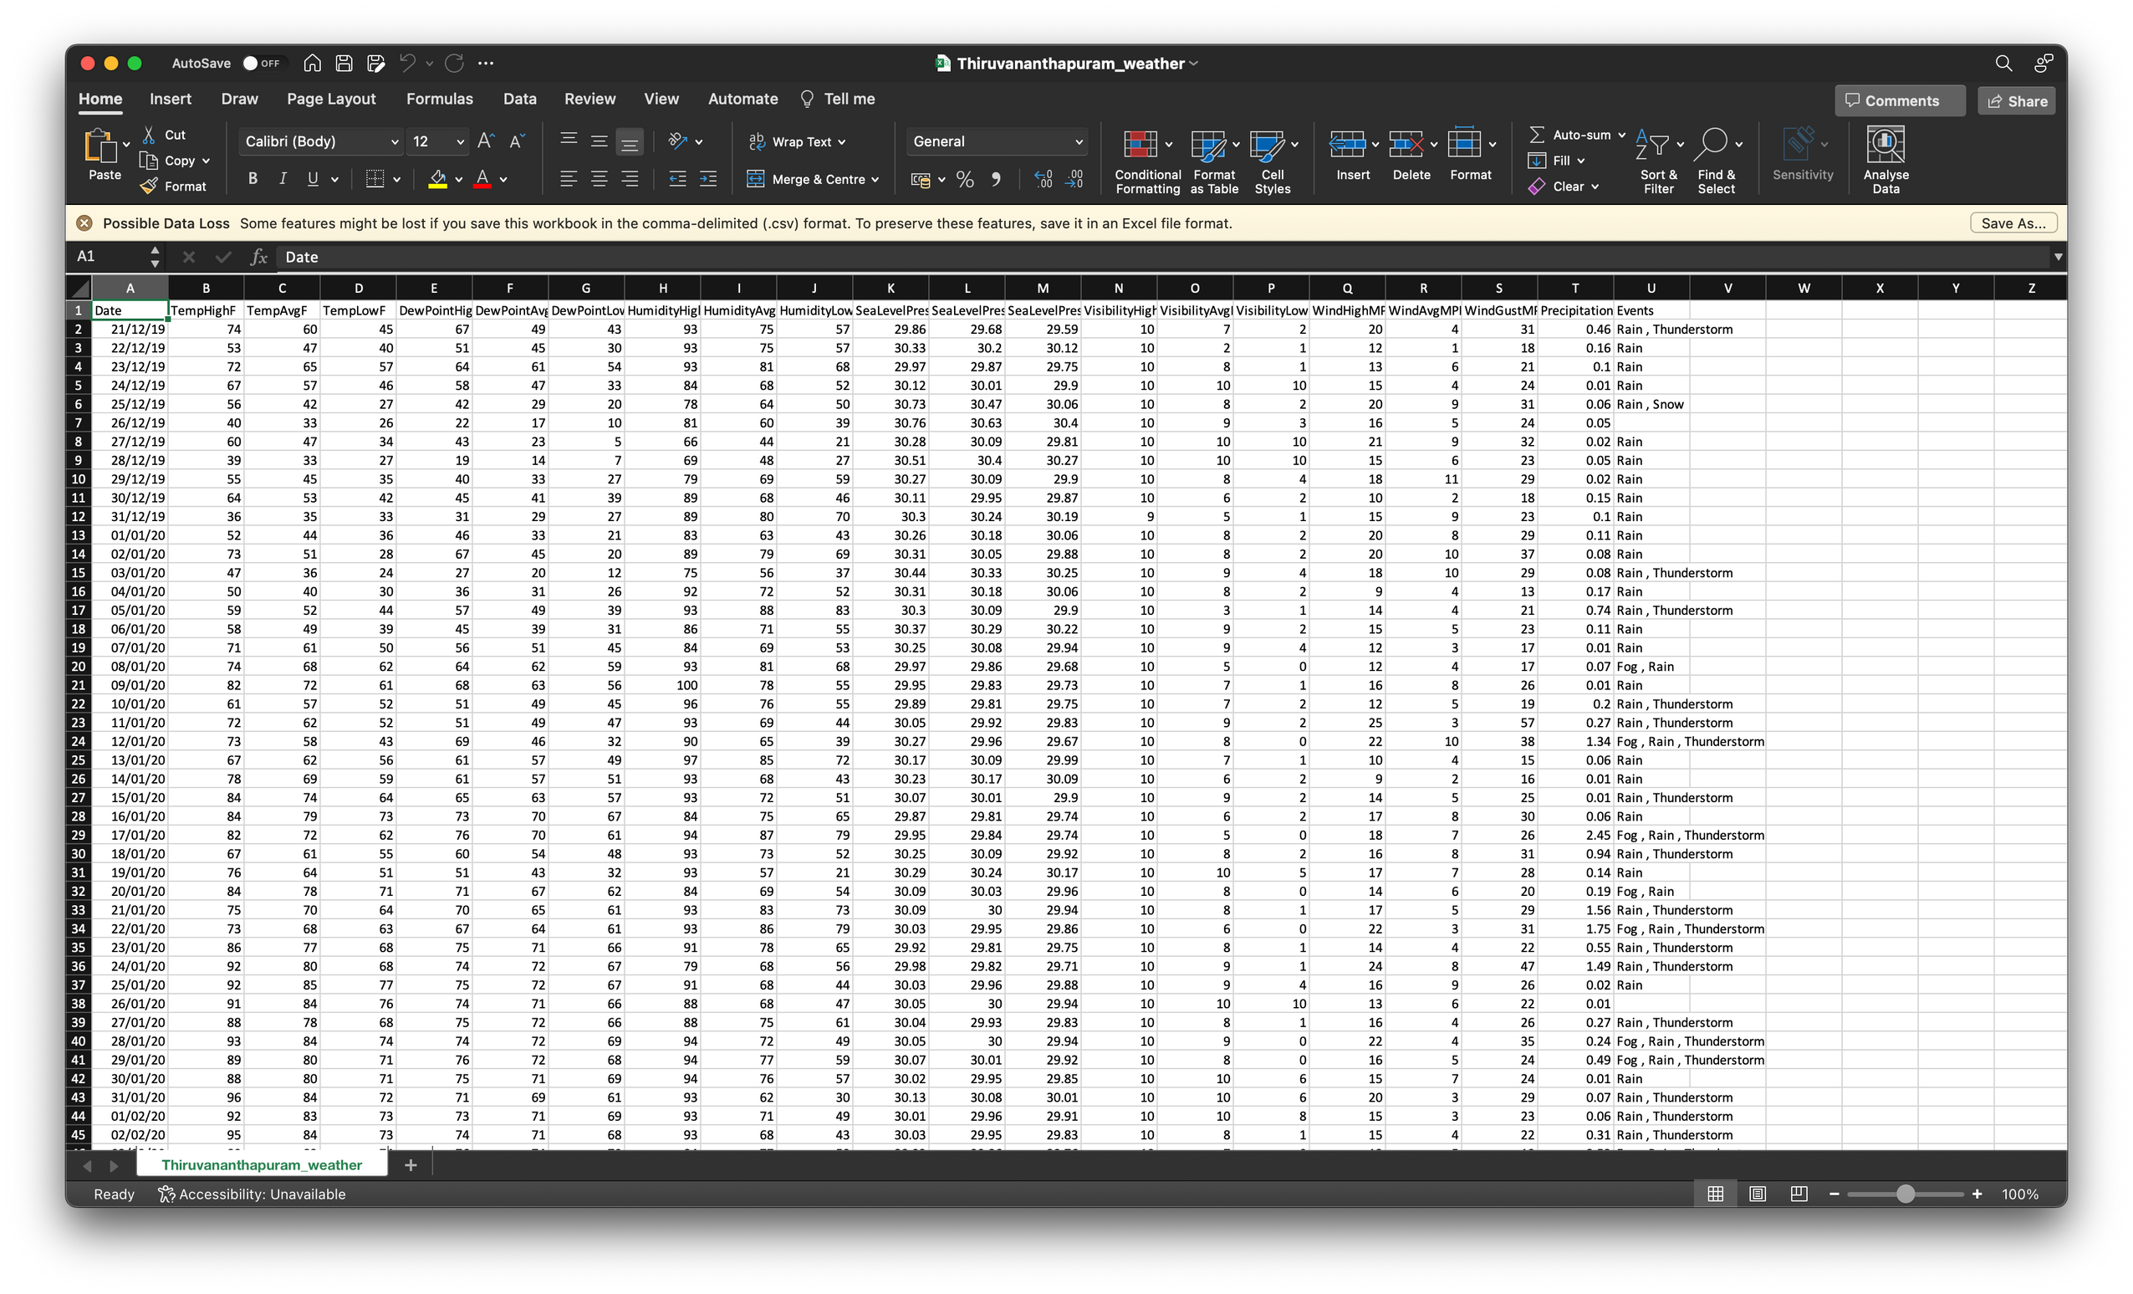

Slide 8
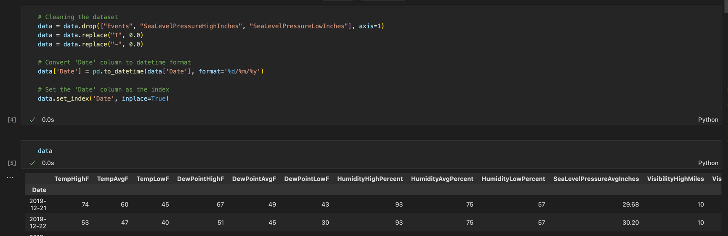
Code Explanation
Reading the dataset from a CSV file.
Dropping unnecessary columns and replaces "T" and "-" values with 0.0.
Converting the 'Date' column to datetime format, sets it as the index.

Slide 9
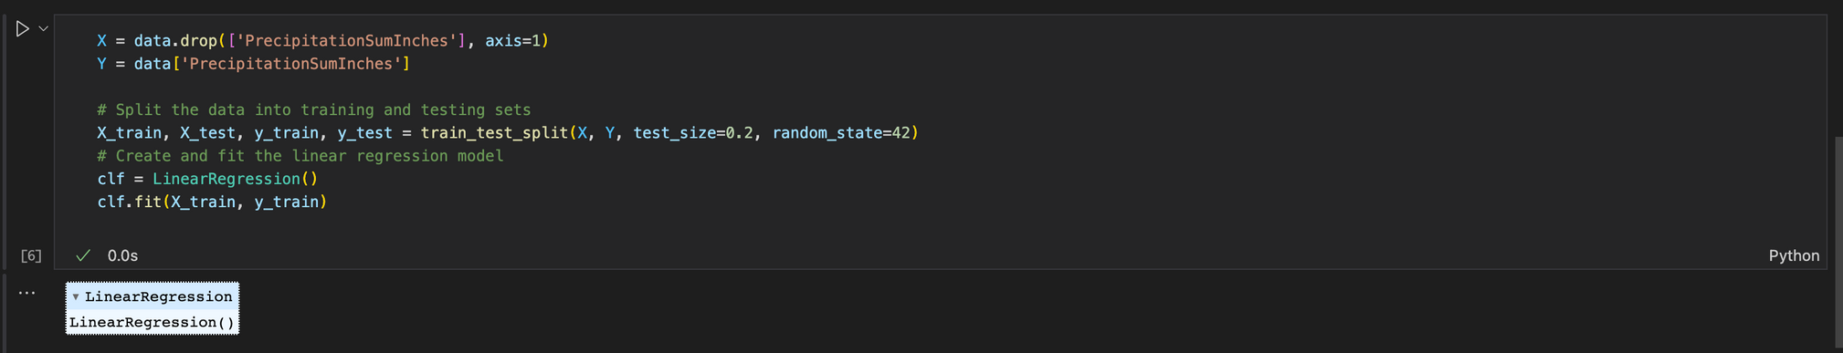
Code Explanation
Split the dataset into features (X) and the target variable (Y).
Divided the data into training and testing sets.
Creating a linear regression model (clf) and trains it using the training data.

Slide 10
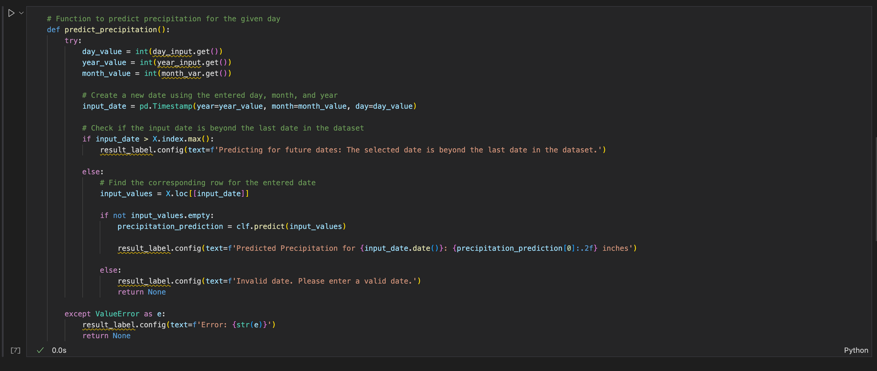
Code Explanation
Takes user input as date, month and year, and predicts precipitation using the trained model.
Displays the result on the GUI

Slide 11
Code Explanation
User Input Retrieval:
The function begins by retrieving the user input values for the day, month, and year from the respective input fields in the GUI (day_input, month_var, year_input).
Create Timestamp:
Using the retrieved day, month, and year values, a pd.Timestamp object (input_date) is created. This represents the date entered by the user.
Check Date Validity:
The function checks if the entered date is beyond the last date in the dataset (X.index.max()). If so, it displays a message indicating that the prediction is for future dates and is beyond the dataset's last date.

Slide 12
Code Explanation
Find Corresponding Row:
If the entered date is within the dataset range, it looks for the corresponding row in the dataset (X.loc[[input_date]]).
Make Prediction:
If the row is found, it uses the trained linear regression model (clf) to predict precipitation for that specific date.
Display Result on GUI:
The result, including the predicted precipitation value, is then displayed on the GUI using the result_label.
Error Handling:
The function includes error handling using a try-except block. If there is a ValueError (e.g., non-integer input for day, month, or year), it catches the exception and displays an error message on the GUI.

Slide 13
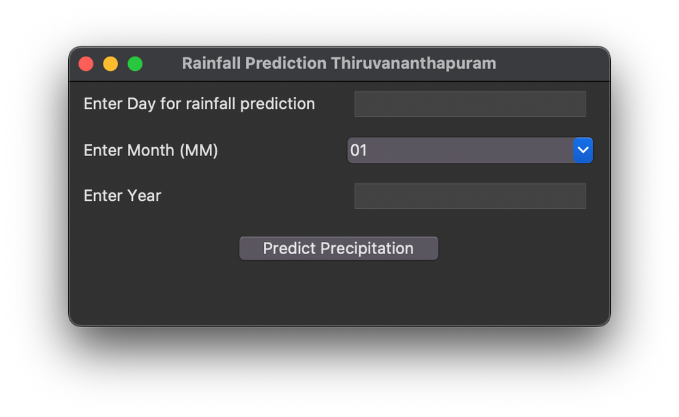
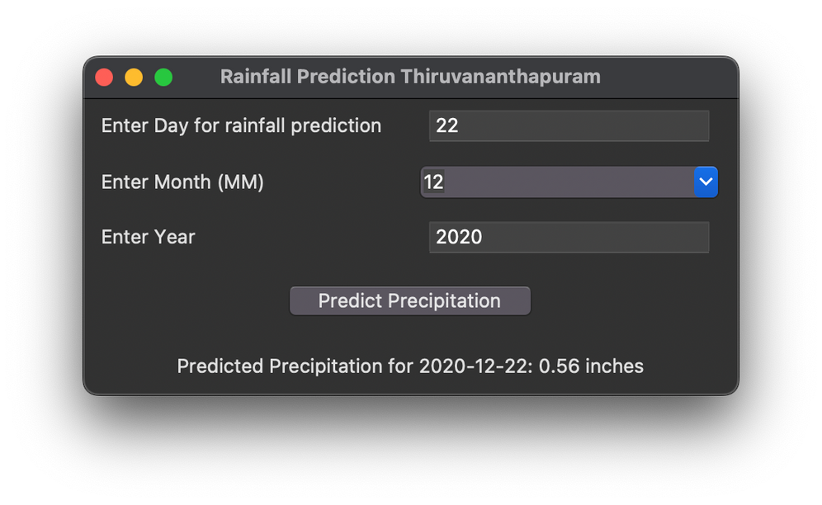
Output
User enters date, month and year to predict rainfall of that day.

Slide 14
Thank You

